Slide 1
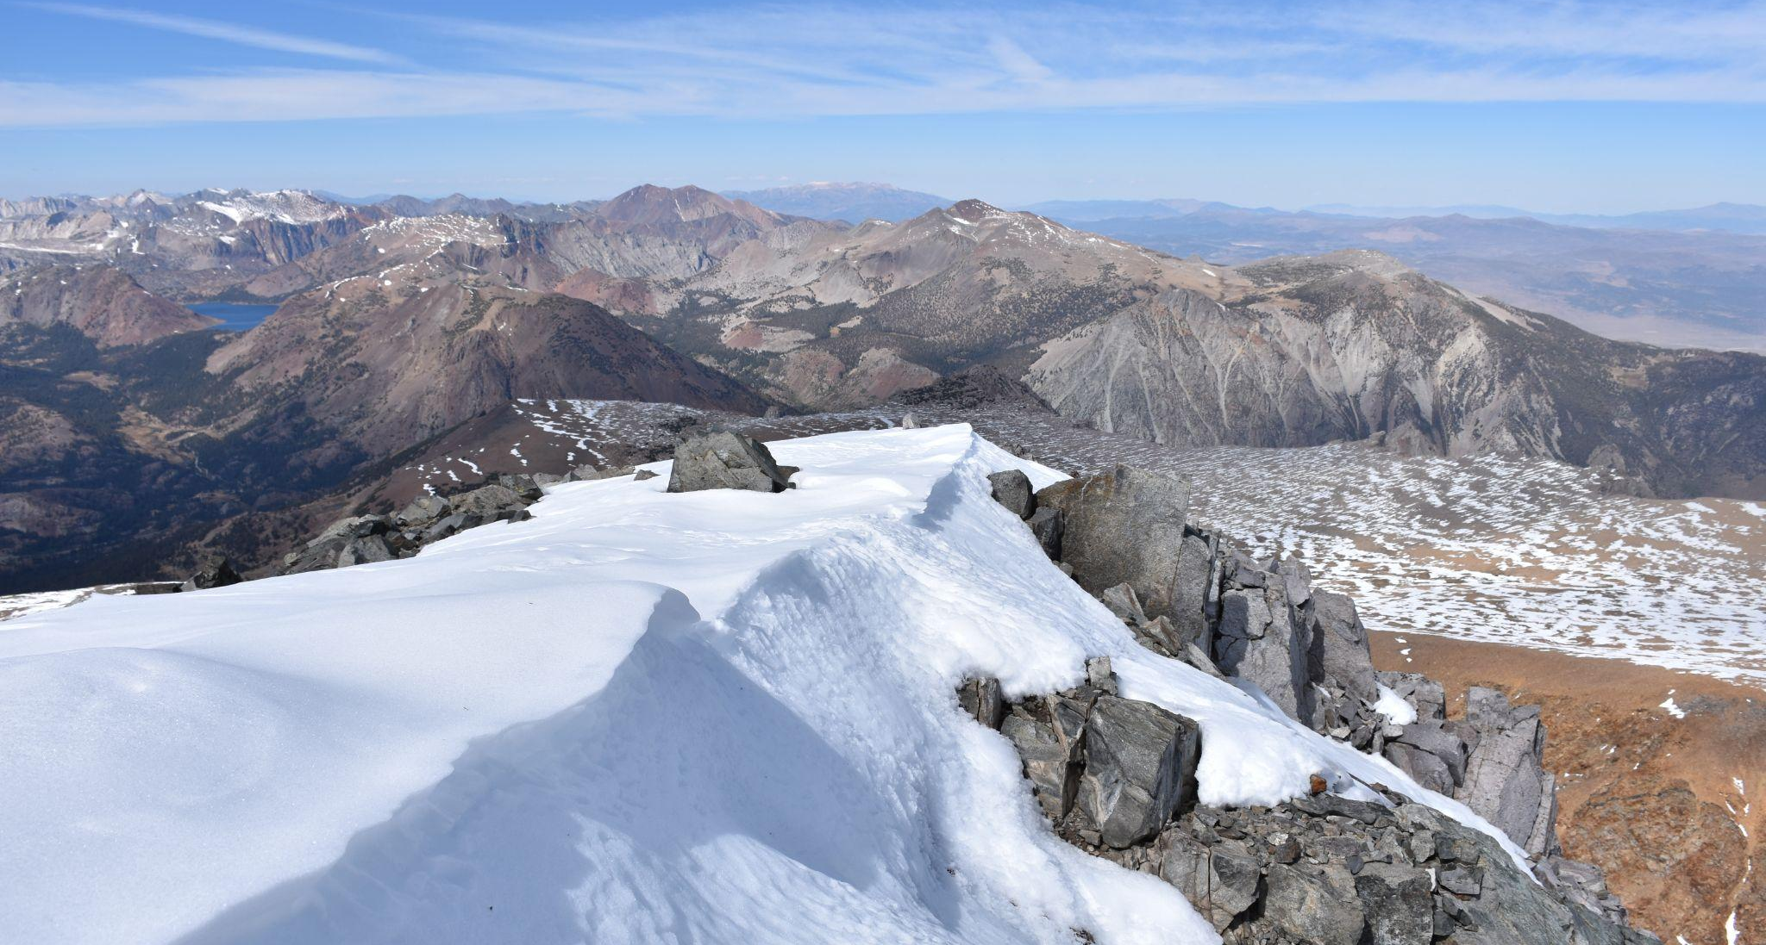
California Snowpack
UC Berkeley MIDS Capstone, Spring 2022
Malachy Moran, Kayla Wopschall, Derrick Hee, Tilman Bayer

Slide 2
Content/Outline to Add
Cf. Final presentation guidance
Overview of the problem
What is SWE and why is it important to predict
How SWE is measured: Main methods Snotel, satellites, ASO (planes)
Previous Work, recommendations by our smes: We first do estimate ASO? Most previous research not using spatial info (like we do in CNN)?
To be confirmed
Proposed timeframe/goals of predictions
Study Area & Scale (gridding etc)
Data Sources & Variables
Imagery Sources
Tabular Data
Modeling
Initial models (brief)
Discussion on approach to future modeling
Results
Reaction/feedback of our smes
Future Work/Considerations, package
Conclusions
THINGS TO KEEP IN MIND: this presentation should be built as if no one listening has any background knowledge of the project/problem. With how many times we’ve presented, we might make assumptions about our audience’s knowledge but the presentation should be geared towards the Showcase with an entirely new audience.

Slide 3
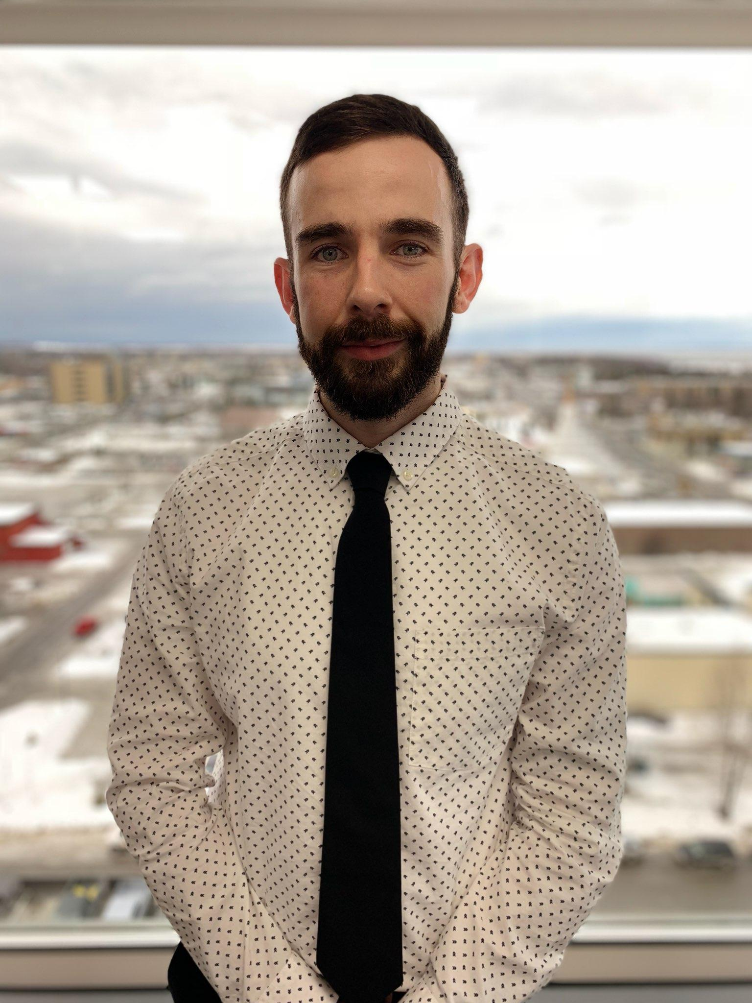


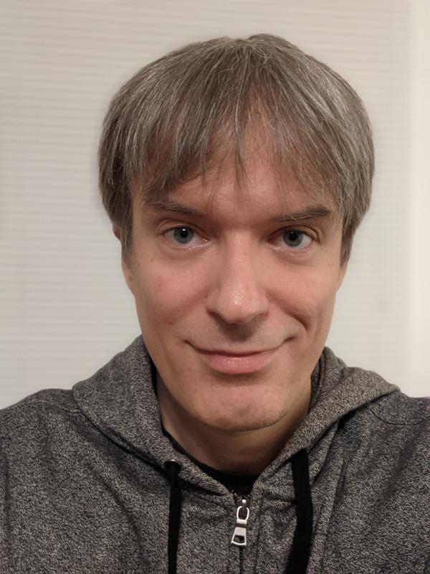
Meet the Team
Malachy Moran
Senior Corporate Analytics Specialist
Kayla Wopschall
Ph.D., Data & Applied Scientist
Derrick Hee
QA Tester
Tilman Bayer
Data Scientist

Slide 4
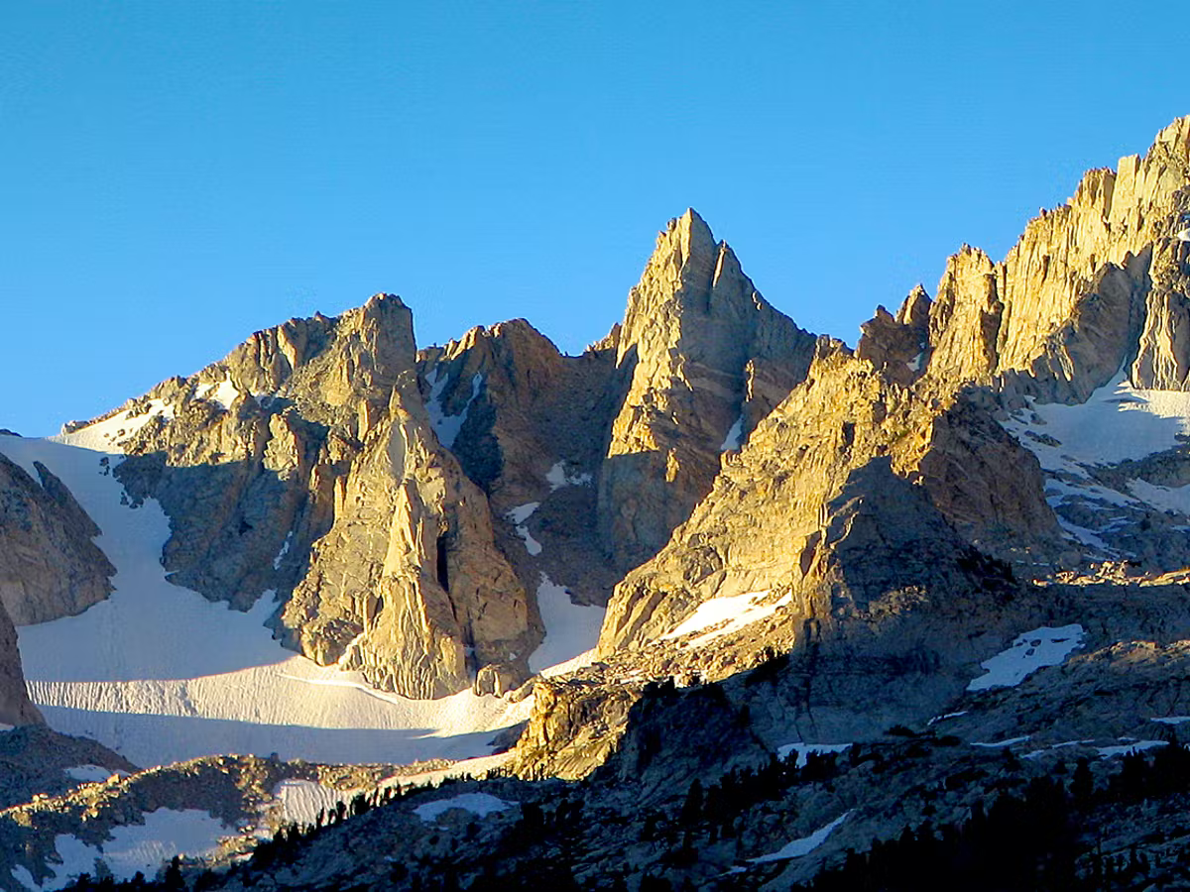
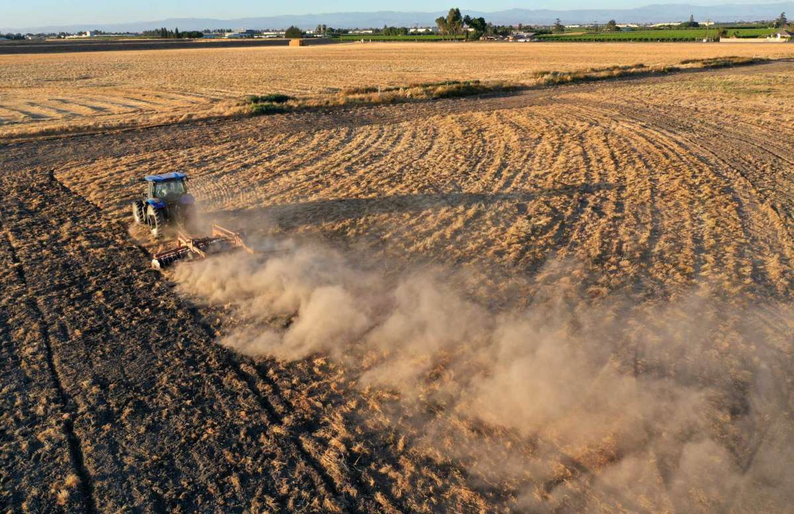
Motivation: California Snowpack and Agricultural Water
As much as 70% of agricultural water in California’s Central Valley estimated to come from the Sierra Nevada mountains.
CA crops account for 13% of ALL US crops.
Billion dollar industry with estimated 800,000 workers.
Sierra Nevada peaks (2)
How much water do we get to use?
CA Central Valley Farming (1)
Notes:
Snowpack serves as a vital annual water storage system. Snow is stored during the winter months and slowly melts out, providing essential hydration to high altitude flora as well as refueling groundwater.
With the increasing temperatures due to climate change, we are seeing a disruption of this natural cycle.
Not only is the snowmelt peak getting hit earlier (~March instead of April), we are seeing more extreme weather in all regions, causing more uncertainty for regions that depend on SWE as a resource.
Being able to estimate the SWE will provide water managers with information to plan out the coming year.

Slide 5
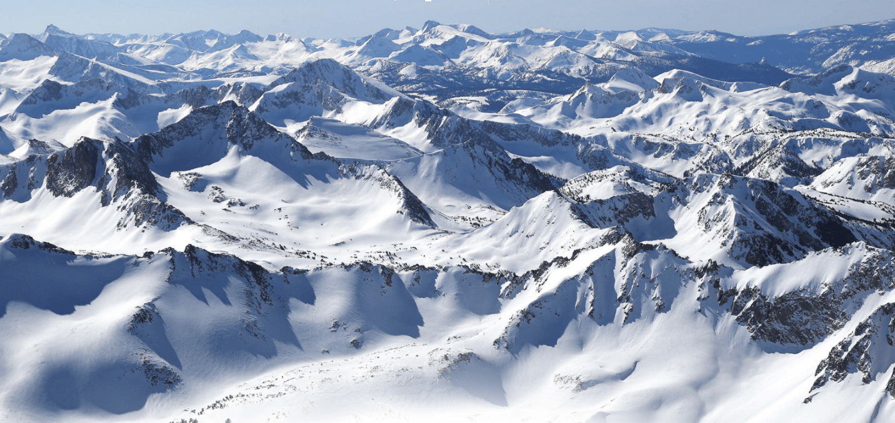
Sierra Nevadas Complexity of Peaks
Highly complex localized weather patterns and highly varied surface characteristics - making estimates of snowpack very difficult. (1)
Sierra Nevada Basins (3)

Slide 6
The Problem
Creating a tool that accurately estimates the amount of snow captured in the Sierra Nevada each year would provide vital information for water management of California.
Consulted subject matter experts:
Prof. Dr. Manuela Girotto & Prof. Dr. Paolo D'Odorico
UC Berkeley Department of Environmental Policy & Management

Slide 7
Measuring Snow & Water
Snow Water Equivalent (SWE)
Amount of water you would expect if you melted the snow present.
Takes into consideration density and snow height.
Affected by accumulation, sublimation, melt…

Slide 8
Previous Work & Our Approach
Existing ways of estimating SWE struggle to achieve accuracy at good Spatial and Temporal resolution.
Automated in-situ (on location) measurements, e.g. SNOTEL (snow telemetry) stations
Most reliable direct measures of SWE
good temporal resolution (LSTM models have been highly successful in filling temporal gaps)
Poor spatial resolution (stations are few and far between)
Highly biased (stations tend to be in accessible location at lower altitudes)
Calculations via satellite imagery
Good spatial and temporal resolution, lots of free data
Indirect calculations, less accurate, requires ground truth to train on

Slide 9
Previous Work & Our Approach
Existing ways of estimating SWE struggle to achieve accuracy at good Spatial and Temporal resolution. (continued)
3. Remote sensing via airplane, e.g. Airborne Snow Observatory (ASO)
Recommended for accuracy by our subject matter experts
Poor temporal resolution (only available for days where flights took place)
Expensive. Proprietary since 2020
Our Approach:
Estimate/predict ASO measurements from a combination of tabular weather data and satellite image data, using both LSTM and CNN modeling methods.

Slide 10
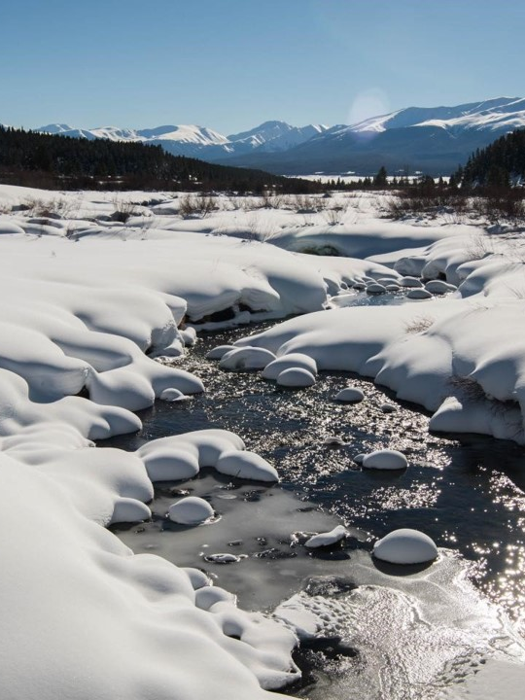
Data & Study Area
Study Area
Methodology
Data Sources & Variables

Slide 11
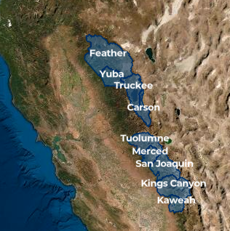
Study Area and Scope
Western Sierra Nevada mountains
9 primary basins
-ASO survey boundaries
*Only the southern Basins were surveyed in 2020 and 2021
2016-2019 Training Data
2020-2022 Test Set
ASO Basins (4)
Notes:
2016-2019, 2020 test(pending)

Slide 12
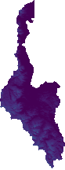
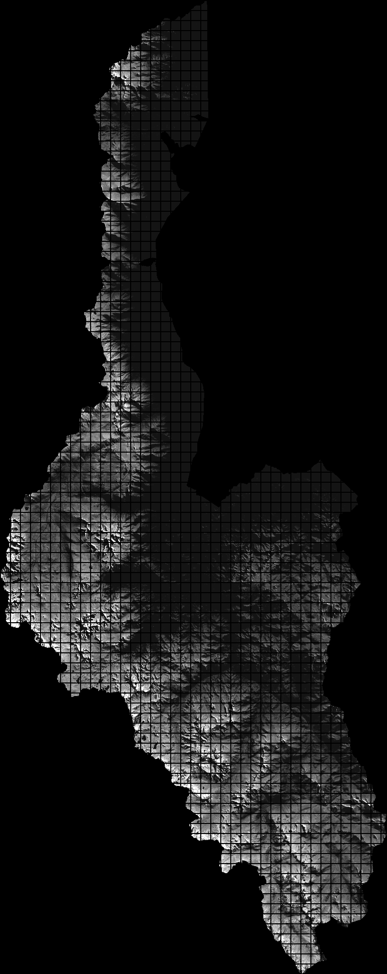
Study Area
Each basin divided into 1km x 1km gridded squares per year
Variables collected by date & geometry for all squares.
Carson Basin. Original ASO Data(Left), Data segmented for prediction (Right)

Slide 13
Summary of Data In Use
Source | Data Type | Resolution | Information Gained
MODIS | Satellite Imagery - Transformed to Tabular | 500m Daily | Snow cover and Albedo
Copernicus | Satellite Imagery - RGB image | 30m Static | Elevation, Slope, Aspect
Sentinel 1 | Satellite Imagery - RGB image | 60m Daily | Detection of wet/dry snow conditions
Sentinel 2 | Satellite Imagery - two RGB images | 60m Daily | 1- Geologic features 2- Vegetation cover
GRIDMET | Satellite Weather Data- Transformed to Tabular | 4km Daily | Weather - Daily Precipitation, Max/Min temp, Wind Direction & Velocity
ASO | Airplane Flyover Remote Sensing - to Tabular | 50m Sporadic | SWE - target variable
Input Variables
Notes:
RGB meaning false color images

Slide 14
Modeling
Architecture
Model Performance

Slide 15
Architecture Choices
CNN
LSTM
Strong ability to extract complex features from images
Leverage more complex architectures with pre-trained weights
Dataset Images
Copernicus
Sentinel 1
Sentinel 2a
Sentinel 2b
Standard architecture when there are important features in sequential data that affects outcome
Weather Data
Precipitation
Temperature
Wind
Notes:
CNN - image feature extraction
LSTM - useful for time series

Slide 16
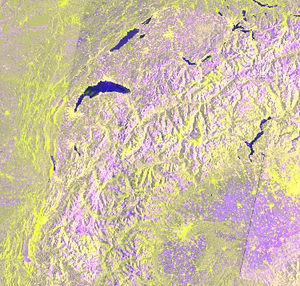
Updated Architecture: CNN-LSTM
CNN Feature Encoder (EnB4, Mixnet)
Per-day image
from
multiple sources
Linear Layers
Temp. | Precip. | …
… | … | …
LSTM
SWE Estimate
1 prediction/cell
Time-series Tabular Data

Slide 17
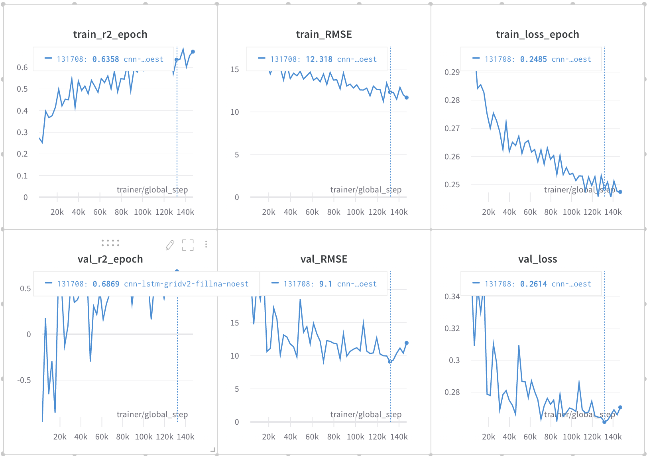
Model performance

Slide 18
Prediction
Prediction Flow
Tool
Results

Slide 19
Prediction Pipeline
Imagery
Temp. | Precip. | …
… | … | …
Tabular Data
Model Weights
Receive a date and a basin name
Make Predictions
Gather Relevant Data
Provide Useful Output
Date can be any date up to the present
Geometry of the area processed into 1kmx1km squares
Data gathered for the specific input date and area
Error handling robust to prevent failure
Output includes:
Imagery
Table

Slide 20
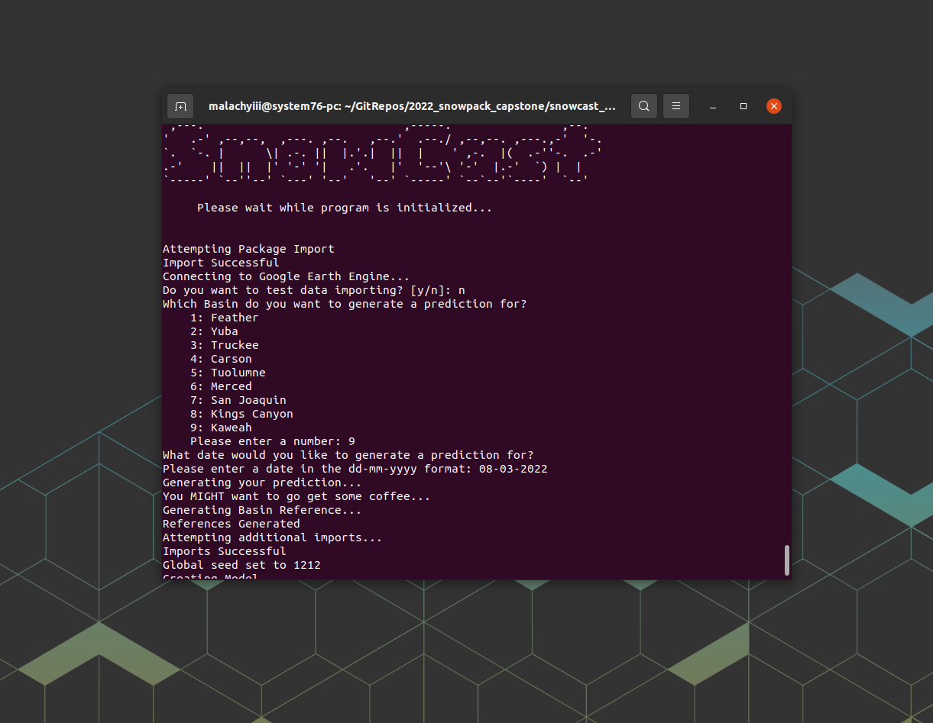
Prediction Tool
Screenshot of Prediction Tool
Tool allows for prediction of any of the 9 ranges that ASO covers.
Can predict any day after the Sentinel missions began (since 2016)
Run from Bash terminal
Run time between 5-21 hrs depending on basin size
Outputs 2 color images and a csv of the data

Slide 21
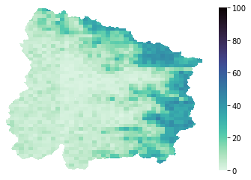
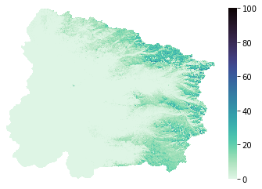
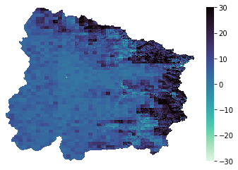
Results
Kaweah Basin Prediction (Left) vs Actual (Right) for March 8th 2022
Using our unseen test set of 2020-2022 we can gauge how the model might perform on real world data.
Using weights with a Validation RMSE of 10.6 inches, we observed a Test RMSE of 11.2 inches
Observing our pixelwise error we see that we overpredict the highlands
Pixelwise Error (Prediction - Actual)

Slide 22
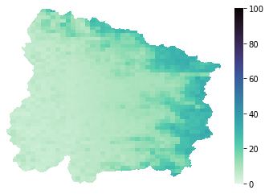
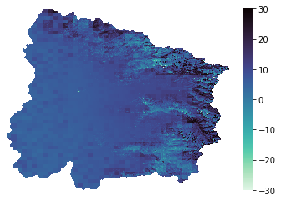
Smoothing
Kaweah Prediction: Original (Left) vs Smoothed (Right) for March 8th 2022
Our model is a lower resolution than the ASO imagery
To better replicate the higher resolution images, Gaussian smoothing can be applied
After smoothing, a test RMSE of ~9.4 inches was observed
Pixelwise Error - Original Prediction (Left) Smoothed Prediction (Right)

Slide 23
Recommendations
Higher Resolution Inputs
Median SWE instead of Average
Further work on Smoothing Functions
More powerful compute hardware - longer time window (LSTM) and more powerful image models
Modify Albedo input - account for recent improvements in the field
Incorporate LiDAR imagery - more accurate canopy/vegetation
Reevaluation of Wind Metrics - to align with most recent research

Slide 24

Packaging - Snowcast
All the functions used for the prediction module are accessible in a python package.
Downloadable via pip install snowcast-Malachyiii import snowcast
Functions can be used to pull data for any areas the satellites cover
Simplifies imagery and tabular data requests to one line of code
See more: snowcast-Malachyiii
https://www.inc.com/joshua-conran/why-your-product-s-packaging-is-as-important-as-the-product-itself.html

Slide 25
Thank You
Special thanks to Prof. Drs. Manuela Girotto & Paolo D'Odorico of UCB’s Department of ESPM, and Prof. Drs. Alberto Todeschini & Puya H. Vahabi of UCB’s MIDS for support and guidance.

Slide 26
References
Images
Title slide: View from the top of Mount Dana, September 2017 (own photo, by Tilman)
1 CA Central Valley Farming: https://s.hdnux.com/photos/01/20/74/61/21220451/3/1200x0.jpg
2 Sierra Nevada peaks https://images.theconversation.com/files/412186/original/file-20210720-17-l3bga2.jpg?ixlib=rb-1.1.0&q=45&auto=format&w=1200&h=900.0&fit=crop
3 Sierra Nevada Basins https://snowbrains.com/origins-sierra-nevada-snow-surveying/
4 ASO Basins https://nsidc.org/data/aso
Sources
1 E.g. Huning/Margulis, “Investigating the Variability of High-Elevation Seasonal Orographic Snowfall Enhancement and its Drivers across the Sierra Nevada, CA” (2018)

